Slide 1

“ SENTIMENT ANALYSIS ON YOUTUBE COMMENTS “
Presented By : Kashmira Shelar
November 15 , 2024

Slide 2
1
INTRODUCTION
Social media platforms like YouTube offer a wealth of user-generated content. By analyzing comments on popular videos, we can gain valuable insights into public opinion.
MGM University | 2024
This presentation focuses on a sentiment analysis of YouTube comments on the recent Bollywood release, "Bhool Bhulaiyaa 3." Using natural language processing techniques, we'll uncover the overall sentiment of viewers and explore key themes within the comments.

Slide 3
2
OVERVIEW
Project goal
To analyze the sentiment of YouTube comments on the movie "Bhool Bhulaiyaa 3" using natural language processing techniques.
MGM University | 2024
Methodology
Expected Outcome
Data collection
Data Preprocessing
Sentiment Analysis
Visualization
To successfully get the comments divided into the sentiments of - Positive , Negative , Neutral .

Slide 4
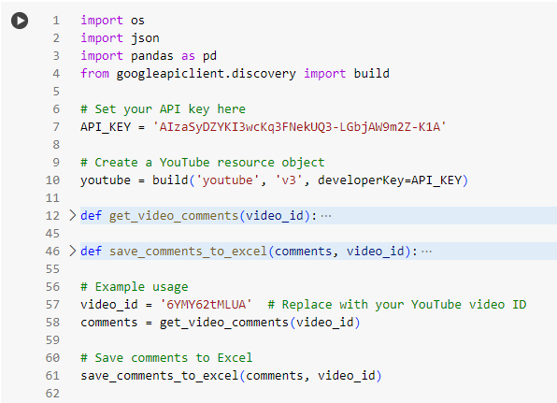
METHODOLOGY
3
Data collection :
YouTube Data API v3
Authentication using API key
Extracting comments for the specified video ID
MGM University | 2024

Slide 5
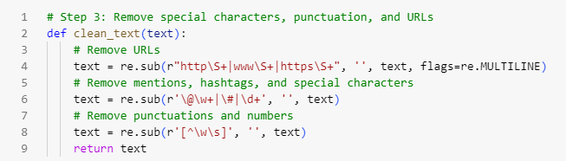
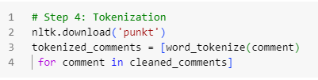
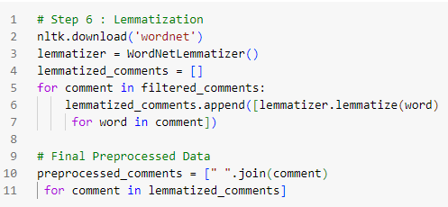
3
Data Preprocessing :
Cleaning the data: Removing stop words, punctuation, and special characters
Tokenization: Breaking text into individual words
Lemmatization: Converting words to their base form (e.g., "loved" to "love")

Slide 6
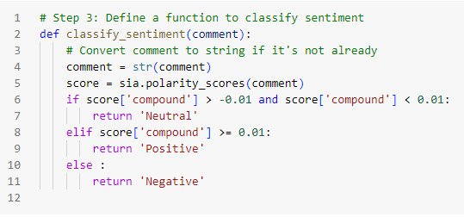

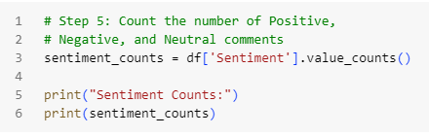
3
Sentiment Analysis :
VADER (Valence Aware Dictionary and sEntiment Reasoner) -
Assigning sentiment scores to each comment (positive, negative, neutral)

Slide 7
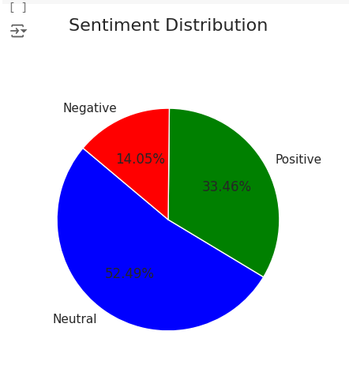
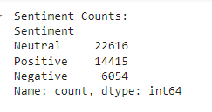
6
RESULTS AND VISUALIZATION
MGM University | 2024

Slide 8
7
LIMITATIONS
VADER's limitations in handling sarcasm, irony, and complex language nuances .
Multilingual Support: VADER is primarily designed for English text and may not be suitable for other languages.
Negation: It can sometimes misinterpret sentences with negation (e.g., "not bad").
MGM University | 2024

Slide 9
8
SCOPE OF THE PROJECT
1
Understanding Public Opinion:
Provides valuable insights into public sentiment towards a specific product, service, or event.
MGM University | 2024
2
Market Research:
Helps businesses identify customer preferences, pain points, and areas for improvement.
3
Social Media Monitoring:
Tracks brand reputation and customer sentiment on social media platforms.

Slide 10
THANK YOU
Presented By : Kashmira Shelar

